Slide 1
Unicorn Cloud Platform Overview
shawn.yang
2016-08-30

Slide 2
System Architecture
Nginx
F5
GW
GW
GW
cluster
Session Center
Portal
Security
Audit
Dashboard
Config Center
Registerserver
Trace
CenterLog
Opts
VM agent
functions
Redis Cluster
Database
MQ Cluster
Mule

Slide 3
Unicorn Cloud Platform
Config Center
Service Register & Discovery
Gateway
Security
Session
Trace & Log

Slide 4
Configuration Center
VM
7000
vmcaretaker
Vm Dashboard
Application
Updating profile/configengine
VM
Opts Shell
7000
vmcaretaker
Manual
Updating profile/configengine
VM
7000
vmcaretaker

Slide 5
Configuration Center Runtime
Config Center
VM
VM
App
App
2
Config Center
2
1
1
7000
7000
vmcaretaker
vmcaretaker
1.request/response profile and configengine address
2.request/response actual configurations based on profile/application/label

Slide 6
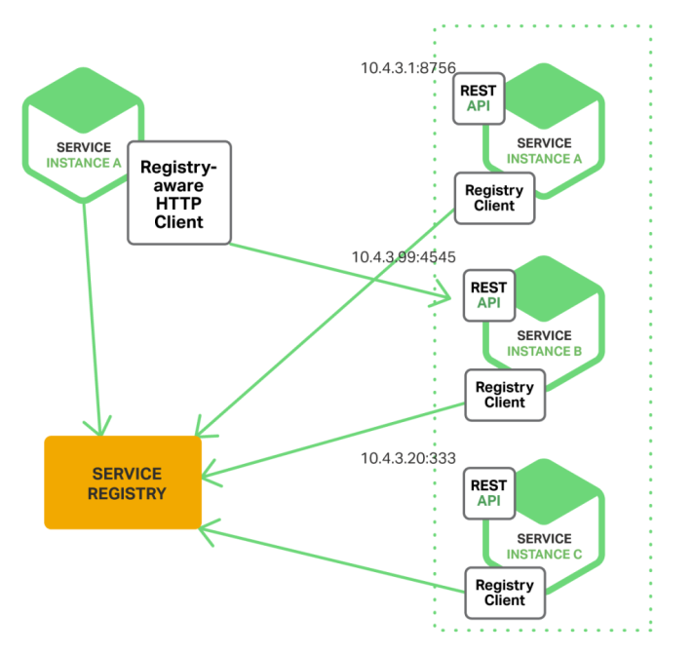
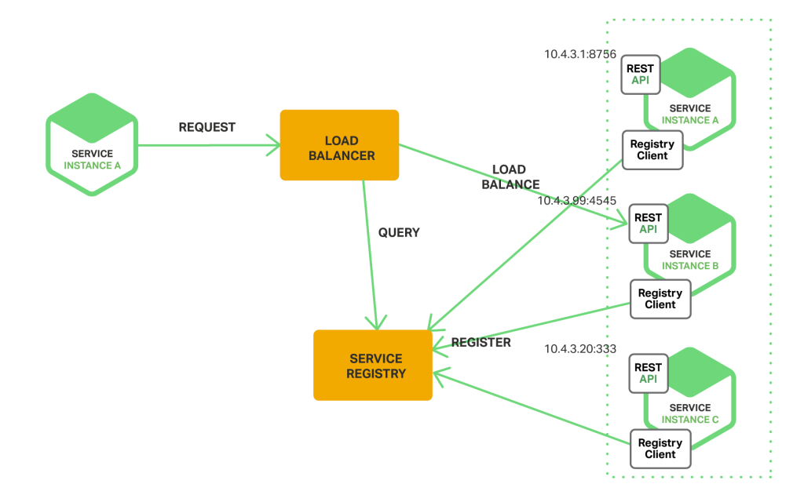
Service Register & Discovery
Client SR & Dis VS Server SR & Dis

Slide 7
Service Register & Discovery
Register Center
topic
queue
MQ Broker
App
App
App
App
lifecycle events
Start Event
Stop Event
Heart Beat Event

Slide 8
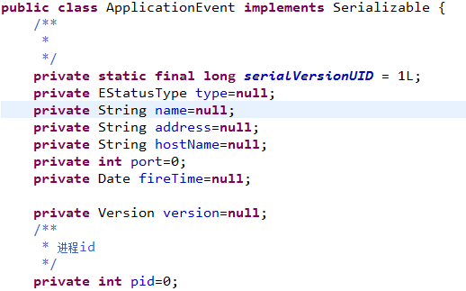
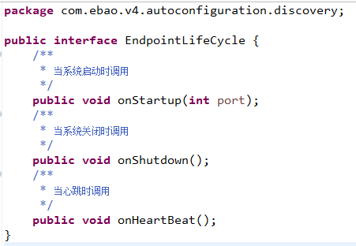
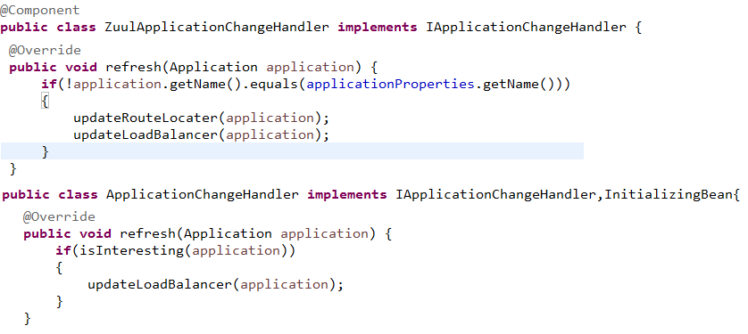
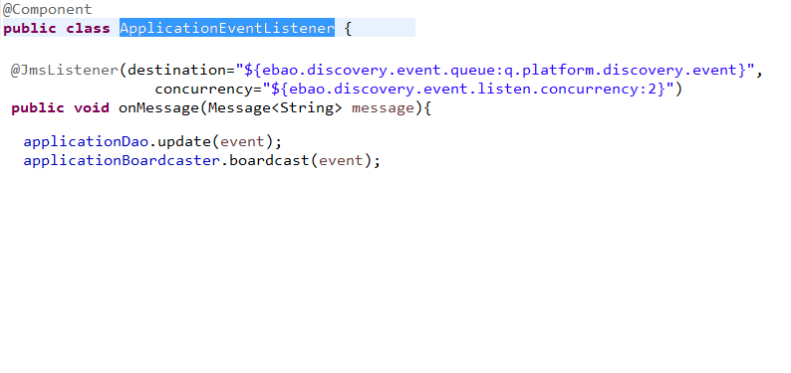
Service Register & Discovery
org.springframework.context.ApplicationListener<E>
public class DiscoveryEndpointStartupListener implements ApplicationListener<EmbeddedServletContainerInitializedEvent>

Slide 9
Gateway
Lb(gateway)
Route Engine
LB Engine
filters
App
App
Route Engine
App
App
App
App

Slide 10
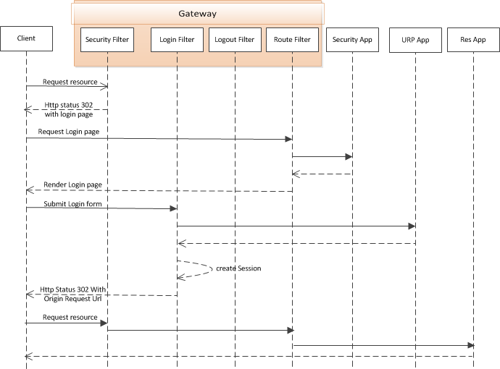
Security

Slide 11
Session
token
GW
Route Engine
LB Engine
token
token
App
token
token
App
Session filter
Redis/session
Session filter
Session mgmt App

Slide 12
Global Log & Audit
Log & Audit App
token
GW
Audit filter
Route Engine
LB Engine
JMS/log & audit event
App
Audit filter

Slide 13


Protocol Transformer
App
Header:appliction/mobile
Header:appliction/thirdapp
Transformer Mgmt App
Transformer definition
GW
Protocol Transsformer filter
Route Engine
LB Engine
Redis/Db
App

Slide 14
Technology Stack
Spring Boot
Starters
Spring Core
Spring Orm
Starters
Spring jms
Application
plugins
Components
Spring Framework
Spring Boot
Spring Cloud
Spring Shell
Redis
MQ
Spring X

Slide 15
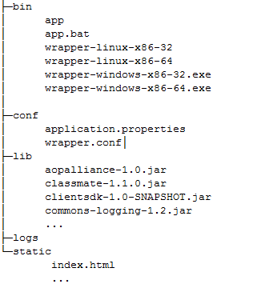
Spring Boot
Delivery media
Spring Boot
Execute Jar
Execute War
Zip

Slide 16
Spring Cloud Netflix
Service Discovery & Discovery(Eureka)
Circuit Breaker $ Dashboard(Hystrix)
Declarative REST Client(Feign)
Load Balancer(Ribbon)
Router & Filter(zuul)

Slide 17
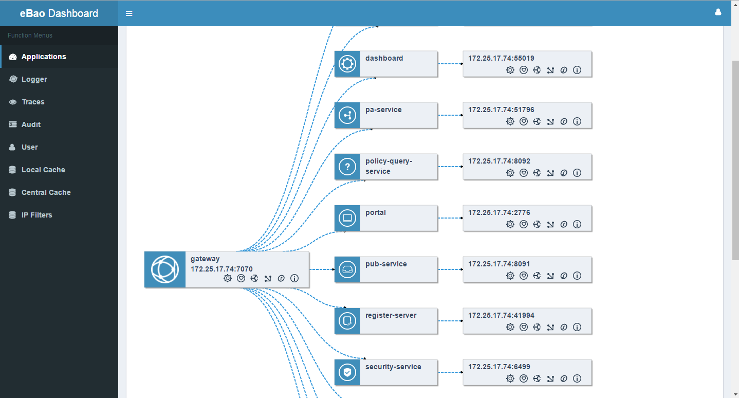
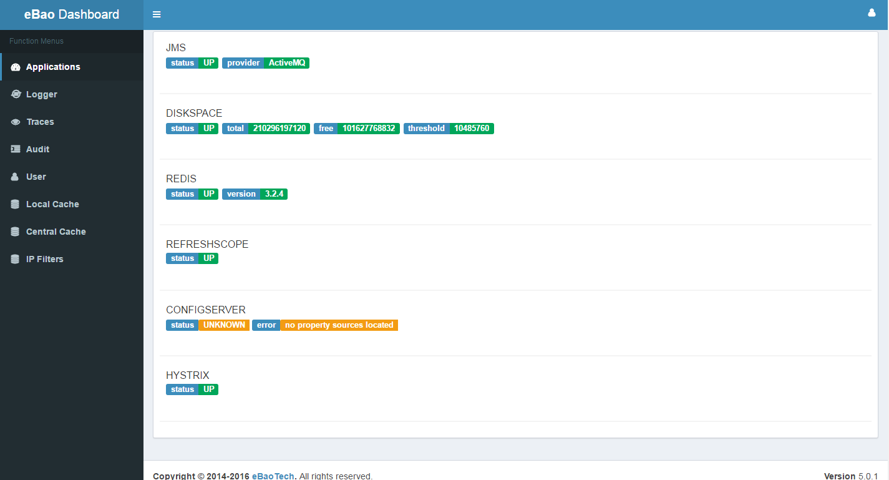
Spring Cloud Dashboard

Slide 18
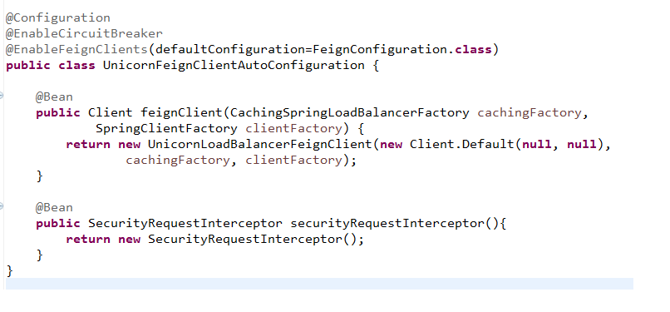
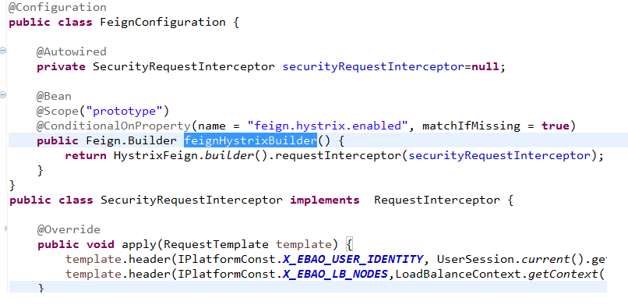
Unicorn Cloud Platform
Feign

Slide 19
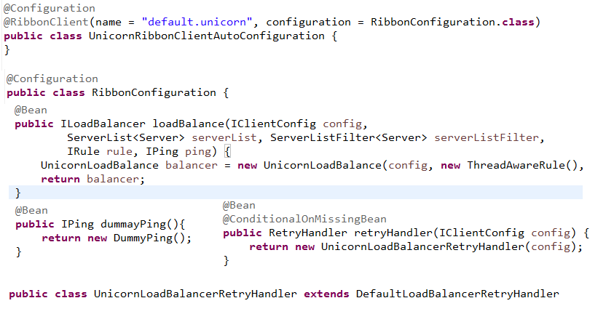
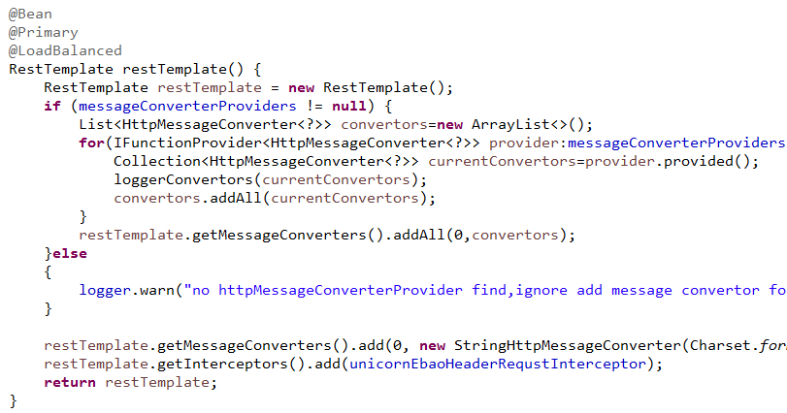
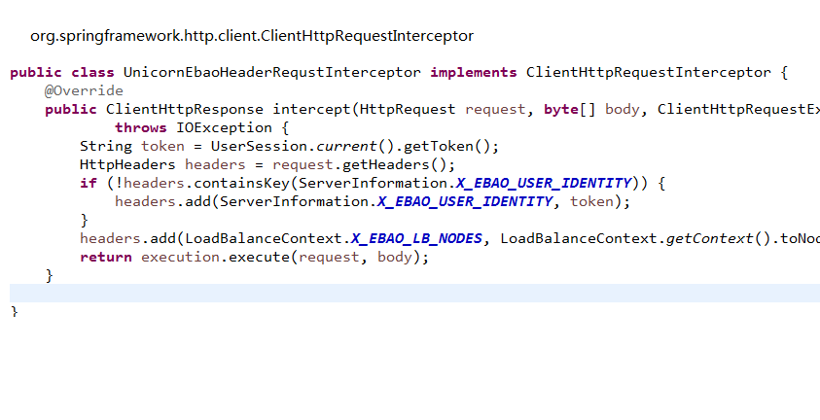
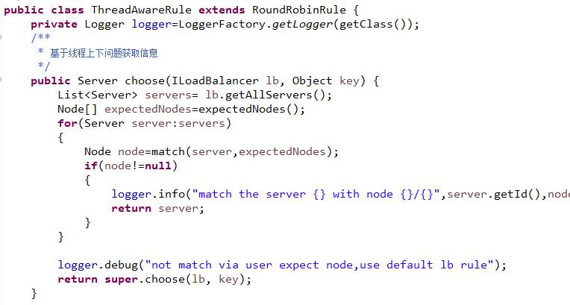
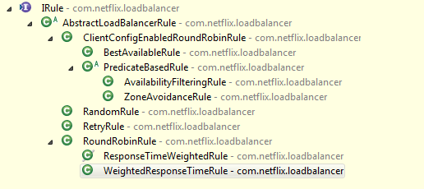
Spring Cloud Netflix
Ribbon
LB Algorithm

Slide 20
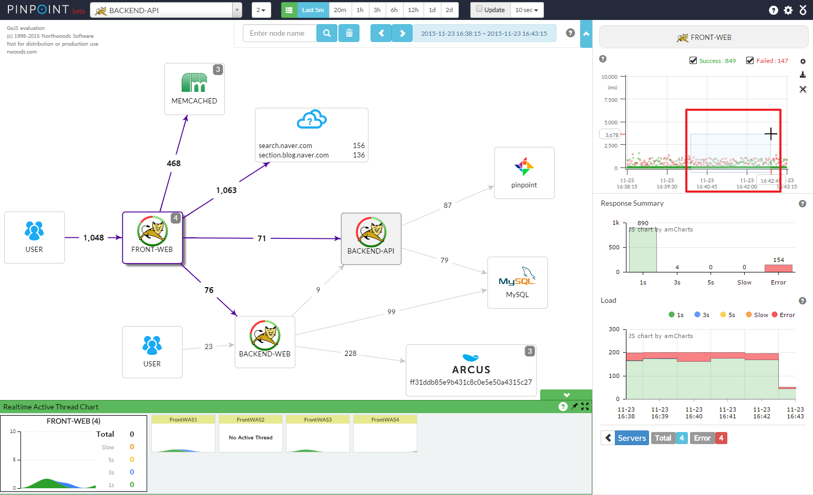
Spring Cloud Sleuth-Pinpoint

Slide 21
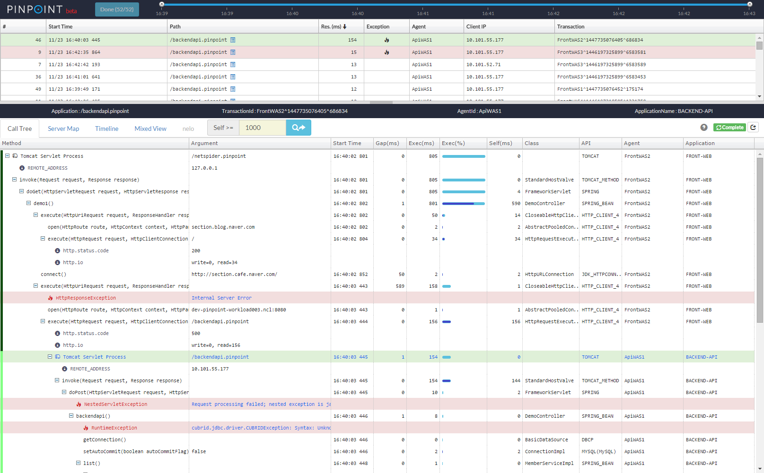
Spring Cloud Sleuth-Pinpoint

Slide 22
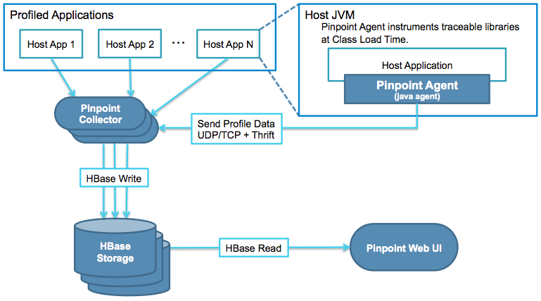
Spring Cloud Sleuth-Pinpoint

Slide 23
Uuicorn Cloud
RelationShip With Other Cloud provider
Unicorn Cloud Platform
Service Adapter
Cloud Platform Provider
X Service Provider
Service Consumer
Service Adapter
Y Service Provider
Service Consumer
Service Adapter
Z Service Provider
IAAS/VM

Slide 24

Unicorn Cloud Platform
References
spring.io
http://projects.spring.io/spring-boot/
http://projects.spring.io/spring-cloud/
http://projects.spring.io/spring-shell/
netflix
http://netflix.github.io/
https://github.com/Netflix/hystrix
https://github.com/OpenFeign/feign
https://github.com/Netflix/ribbon
https://github.com/Netflix/zuul
infoq
http://www.infoq.com/cn/articles/microframeworks1-spring-boot
http://www.infoq.com/cn/articles/boot-microservices
http://www.infoq.com/cn/articles/basis-frameworkto-implement-micro-service
dockone.io
http://dockone.io/article/1646
http://dockone.io/article/394
http://dockone.io/article/482
http://dockone.io/article/549
http://dockone.io/article/771
http://dockone.io/article/936
http://dockone.io/article/1066
http://dockone.io/article/1266
Blog
http://martinfowler.com/articles/microservices.html

